Slide 1


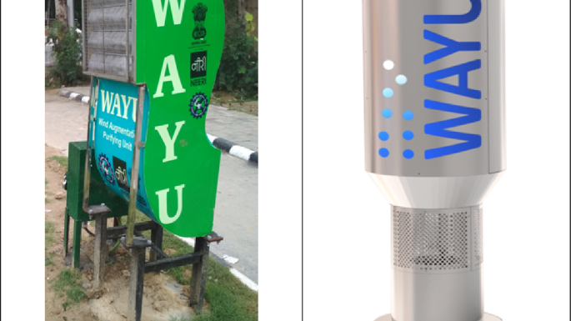
The air quality checker

Slide 2
Table of content
Introduction
Problems
Solution
Features
Parameters
Data
Visualization

Slide 3
introduction
Air quality checkers are devices that measure air quality.
They are used to detect the levels of pollutants in the air, such as carbon dioxide, ozone, and particulate matter.
Air quality checkers can be used indoors or outdoors, and they can be used to monitor air quality in real time or over time.
Air quality checkers are important because they can help people to identify and avoid air pollution.
Air pollution can cause a variety of health problems, including respiratory problems, heart disease, and cancer.
By using an air quality checker, people can take steps to protect their health from the harmful effects of air pollution.

Slide 4
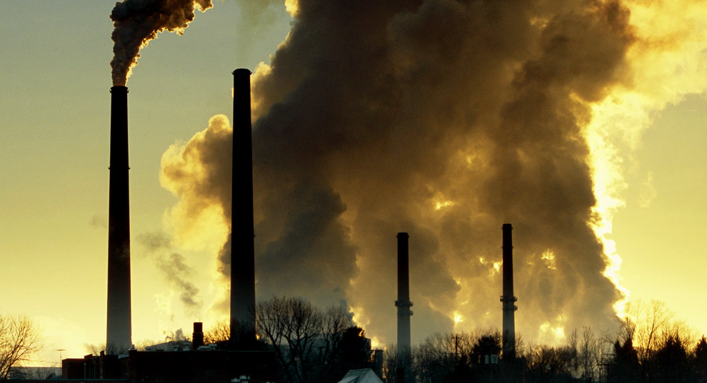

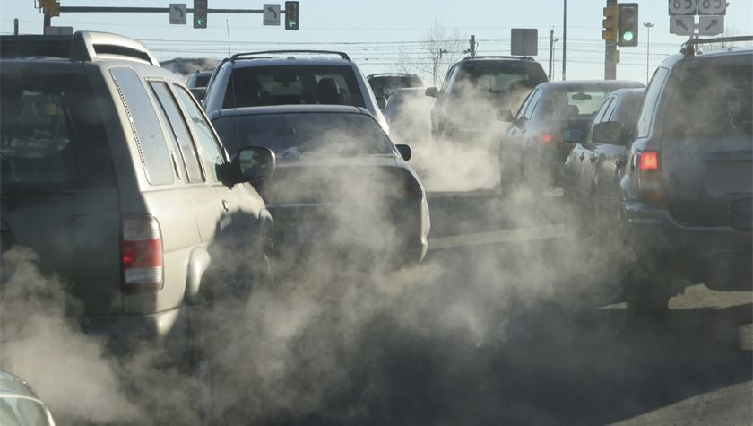
Problems
Dirty Air
Smog
Car smoke
Coal smoke
Car exhaust
Chemical fumes
Heavy metals
Indoor smells

Slide 5
solution

